Slide 1
DATA SCIENCE Machine Learning
Internship
Report

Slide 2

DATA SCIENCE Machine Learning
About Einfochips
My role in company
Internship and project definition
Training
Scope and learning aspects
Project details
About Einfochips
My role in company
Internship and project definition
Training
Scope and learning aspects
Project details
Project link
Internship
Report

Slide 3
DATA SCIENCE Machine Learning
About Einfochips
My role in company
Internship and project definition
Training
Scope and learning aspects
Project details
Project link
Internship
Report

Slide 4


EInfochips - An ARROW COMPANY
eInfochips, an Arrow company, is a leading provider of digital transformation and product engineering services. eInfochips accelerates time to market for its customers with its expertise in IoT, AI/ML, security, sensors, silicon, wireless, cloud, and power.

Slide 5
EInfochips - An ARROW COMPANY
eInfochips is a dynamic and global company with countless opportunities for career development. They believe that our success lies upon the skills and quality of our talented resources. Hence, They inspire people to successfully unleash their full career potential synergized with our business growth.
eInfochips, an Arrow company, is a leading provider of digital transformation and product engineering services. eInfochips accelerates time to market for its customers with its expertise in IoT, AI/ML, security, sensors, silicon, wireless, cloud, and power.

Slide 6
EInfochips - An ARROW COMPANY
eInfochips is a dynamic and global company with countless opportunities for career development. They believe that our success lies upon the skills and quality of our talented resources. Hence, They inspire people to successfully unleash their full career potential synergized with our business growth.

Slide 7
My role in Einfochips
DIGITAL DATA [ Data Science And Machine Learning ]
As an intern at eInfochips an Arrow Company, I am thrilled to have the opportunity to learn data science and machine learning with working on real-world projects.
Having responsible work role, I have assigned task to build the model according to data and keep improving model accuracy until it gives satisfactory result
eInfochips is a dynamic and global company with countless opportunities for career development. They believe that our success lies upon the skills and quality of our talented resources. Hence, They inspire people to successfully unleash their full career potential synergized with our business growth.

Slide 8
My role in Einfochips
DIGITAL DATA [ Data Science And Machine Learning ]
As an intern at eInfochips an Arrow Company, I am thrilled to have the opportunity to learn data science and machine learning with working on real-world projects.
Having responsible work role, I have assigned task to build the model according to data and keep improving model accuracy until it gives satisfactory result
eInfochips is a dynamic and global company with countless opportunities for career development. They believe that our success lies upon the skills and quality of our talented resources. Hence, They inspire people to successfully unleash their full career potential synergized with our business growth.

Slide 9
My role in Einfochips
DIGITAL DATA [ Data Science And Machine Learning ]
As an intern at eInfochips an Arrow Company, I am thrilled to have the opportunity to learn data science and machine learning with working on real-world projects.
Having responsible work role, I have assigned task to build the model according to data and keep improving model accuracy until it gives satisfactory result
eInfochips is a dynamic and global company with countless opportunities for career development. They believe that our success lies upon the skills and quality of our talented resources. Hence, They inspire people to successfully unleash their full career potential synergized with our business growth.

Slide 10
TRAINING
In person
&
Self paced

Slide 11
TRAINING
In person
&
Self paced

Slide 12




TRAINING
Packages
Numpy
Pandas
Matplotlib
Seaborn
Scikit-learn
Tools
Jupyter Notebook
Pycharm
Google Colab
MySQL
Language
SQL
Python

Slide 13
TRAINING
Packages
Numpy
Pandas
Matplotlib
Seaborn
Scikit-learn
Tools
Jupyter Notebook
Pycharm
Google Colab
MySQL
Power BI
Language
SQL
Python

Slide 14
02
Training
01
03
MACHINE LEARNING
PYTHON & LIBRARIES
AJILE & JIRA GIT & GITHUB
PANDAS,NUMPY,
MATPLOTLIB,
SEABORN
DIFRRENT CLASSIFICATION,
REGRESSION ALGORITHMS
INCLUDING SELF PACED COURCE

Slide 15
02
Training
01
03
AJILE & JIRA GIT & GITHUB
MACHINE LEARNING
PYTHON & LIBRARIES
INCLUDING SELF PACED COURCE
PANDAS,NUMPY,
MATPLOTLIB,
SEABORN
DIFRRENT CLASSIFICATION,
REGRESSION ALGORITHMS

Slide 16
Training
01
02
03
AJILE & JIRA GIT & GITHUB
PYTHON & LIBRARIES
MACHINE LEARNING
INCLUDING SELF PACED COURCE
PANDAS,NUMPY,
MATPLOTLIB,
SEABORN
DIFRRENT CLASSIFICATION,
REGRESSION ALGORITHMS

Slide 17
Training
01
02
03
MACHINE LEARNING
AJILE & JIRA GIT & GITHUB
PYTHON & LIBRARIES
DIFRRENT CLASSIFICATION,
REGRESSION ALGORITHMS
INCLUDING SELF PACED COURCE
PANDAS,NUMPY,
MATPLOTLIB,
SEABORN

Slide 18
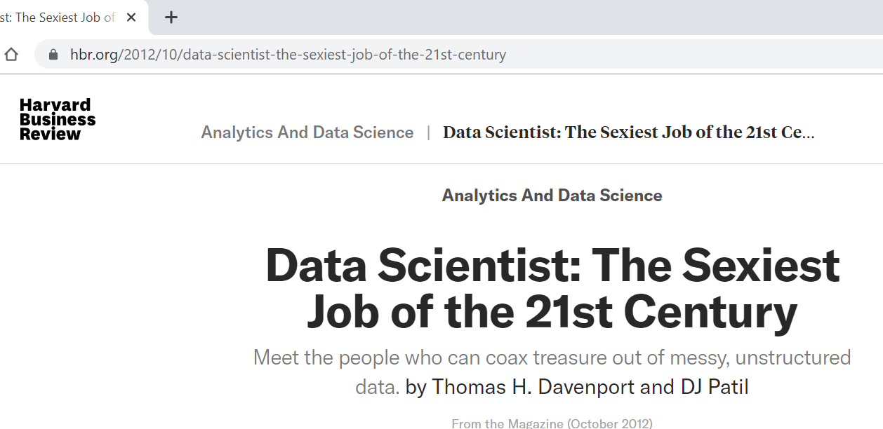
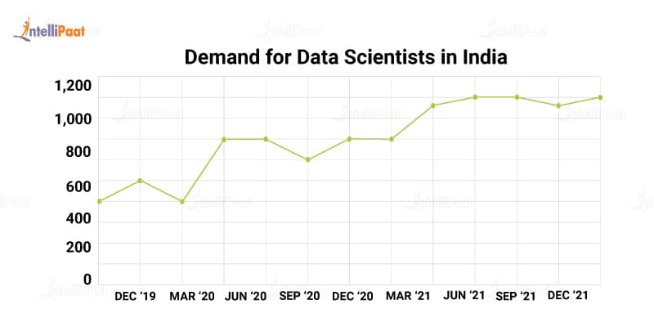
Scope and learning aspects
According to the Harvard business review and Harvard business school : the data science is the sexiest job of the 21st Century
The US Bureau of Labor Statistics predicts the employment rate of data scientists will increase by 36% from 2021 to 2031.
The global data science platform market is anticipated to grow at a CAGR of 33.6% until 2030, from USD 4.7 billion in 2020 to USD 79.7 billion in 2030.

Slide 19
Scope and learning aspects
According to the Harvard business review and Harvard business school : the data science is the sexiest job of the 21st Century
The US Bureau of Labor Statistics predicts the employment rate of data scientists will increase by 36% from 2021 to 2031.
The global data science platform market is anticipated to grow at a CAGR of 33.6% until 2030, from USD 4.7 billion in 2020 to USD 79.7 billion in 2030.

Slide 20
Scope and learning aspects
According to the Harvard business review and Harvard business school : the data science is the sexiest job of the 21st Century
The US Bureau of Labor Statistics predicts the employment rate of data scientists will increase by 36% from 2021 to 2031.
The global data science platform market is anticipated to grow at a CAGR of 33.6% until 2030, from USD 4.7 billion in 2020 to USD 79.7 billion in 2030.

Slide 21
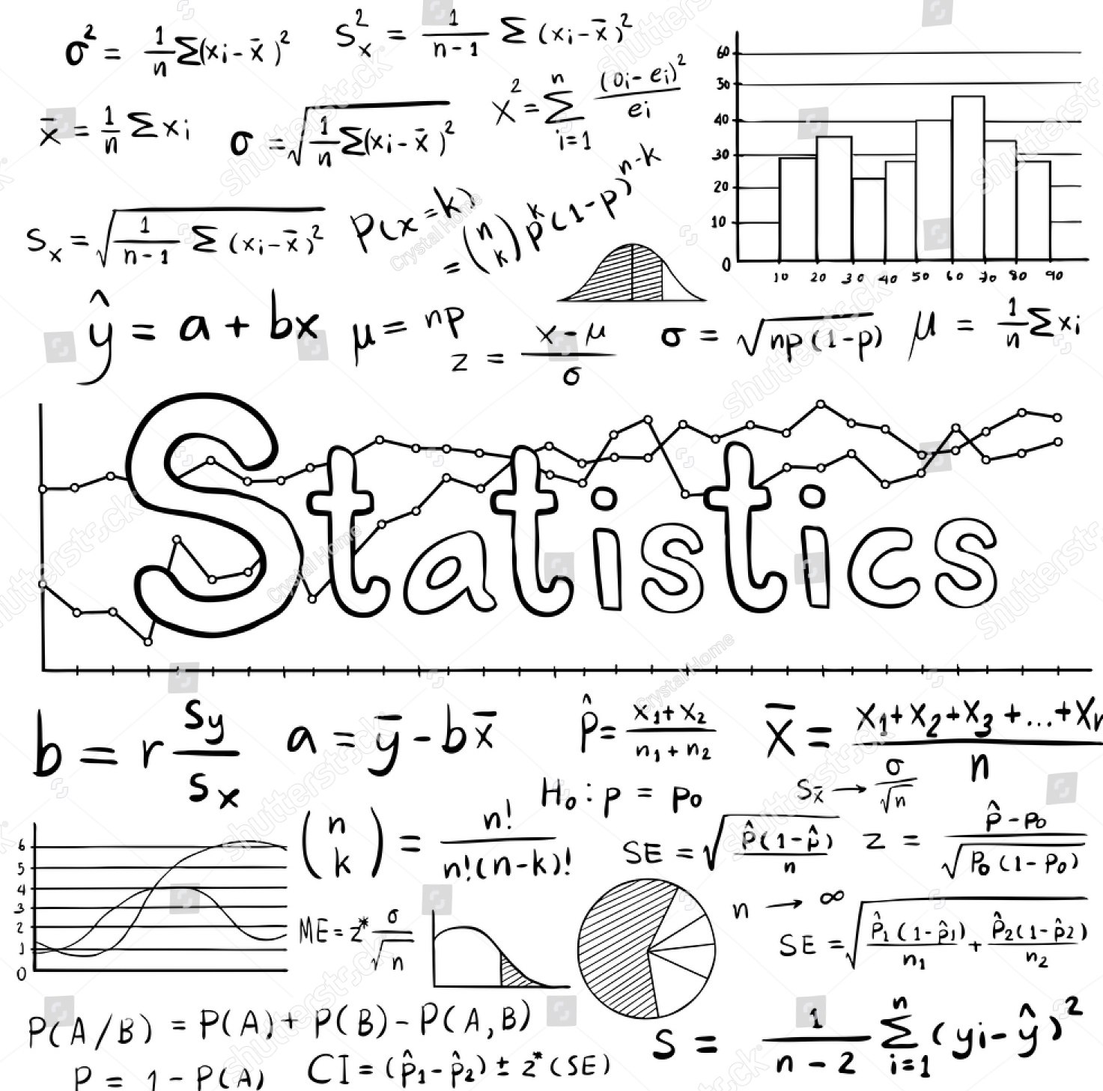

According to the Harvard business review and Harvard business school : the data science is the sexiest job of the 21st Century
learning
The US Bureau of Labor Statistics predicts the employment rate of data scientists will increase by 36% from 2021 to 2031.
The global data science platform market is anticipated to grow at a CAGR of 33.6% until 2030, from USD 4.7 billion in 2020 to USD 79.7 billion in 2030.
Statistics behind Ml models

Slide 22


learning
Statistics behind Ml models
Communication

Slide 23


learning
Learning pace & handling multiple task at same time
Statistics behind Ml models
Communication

Slide 24




learning
Learning pace & handling multiple task at same time
Reporting tool
Power BI

Slide 25


learning
Reporting tool
Power BI

Slide 26


learning
Learning pace & handling multiple task at same time

Slide 27
PROJECT
Problem
Solution
To build a Machine Learning classification model that predicts the behaviour of customer using different python,EDA,classification model
A telecom company having data of their customer in which some of them are churner, the problem is to find the churner behavior and retain the customers

Slide 28
PROJECT
Problem
Solution
A telecom company having data of their customer in which some of them are churner, the problem is to find the churner behavior and retain the customers
To build a Machine Learning classification model that predicts the behaviour of customer using different python,EDA,classification model

Slide 29

PROJECT
Problem
Solution
A telecom company having data of their customer in which some of them are churner, the problem is to find the churner behavior and retain the customers
To build a Machine Learning classification model that predicts the behaviour of customer using different python,EDA,classification model

Slide 30


Project Workflow
DATA PREPROCESSING
EDA
Model building
Feture engin.
Cleaning up data using
Pandas and numpy libraries
It is useful to gain the important insights of data
Classification Model
That can predict the output class label
Transform data into appropriate format so it can feed into model

Slide 31
Project Workflow
DATA PREPROCESSING
EDA
Model building
Feture engin.
Cleaning up data using
Pandas and numpy libraries
It is useful to gain the important insights of data
Classification Model
That can predict the output class label
Transform data into appropriate format so it can feed into model

Slide 32
Project Workflow
DATA PREPROCESSING
EDA
Model building
Feture engin.
Cleaning up data using
Pandas and numpy libraries
It is useful to gain the important insights of data
Classification Model
That can predict the output class label
Transform data into appropriate format so it can feed into model

Slide 33
Project Workflow
DATA PREPROCESSING
EDA
Feture engin.
Model building
Cleaning up data using
Pandas and numpy libraries
It is useful to gain the important insights of data
Transform data into appropriate format so it can feed into model
Classification Model
That can predict the output class label

Slide 34
Project Workflow
DATA PREPROCESSING
EDA
Feture engin.
Model building
Cleaning up data using
Pandas and numpy libraries
It is useful to gain the important insights of data
Transform data into appropriate format so it can feed into model
Classification Model
That can predict the output class label

Slide 35
Project
DATA PREPROCESSING

Slide 36
Project
DATA PREPROCESSING

Slide 37
Project
DATA PREPROCESSING

Slide 38
Project
DATA PREPROCESSING

Slide 39
Project (EDA)

Slide 40
Project (EDA)

Slide 41
Project (EDA)

Slide 42
Project (EDA)

Slide 43
Project (EDA)

Slide 44
Project (EDA)

Slide 45
MODEL
01
DECISION TREE
(with imbalanced data)

Slide 46
MODEL
01
DECISION TREE
(with imbalanced data)

Slide 47
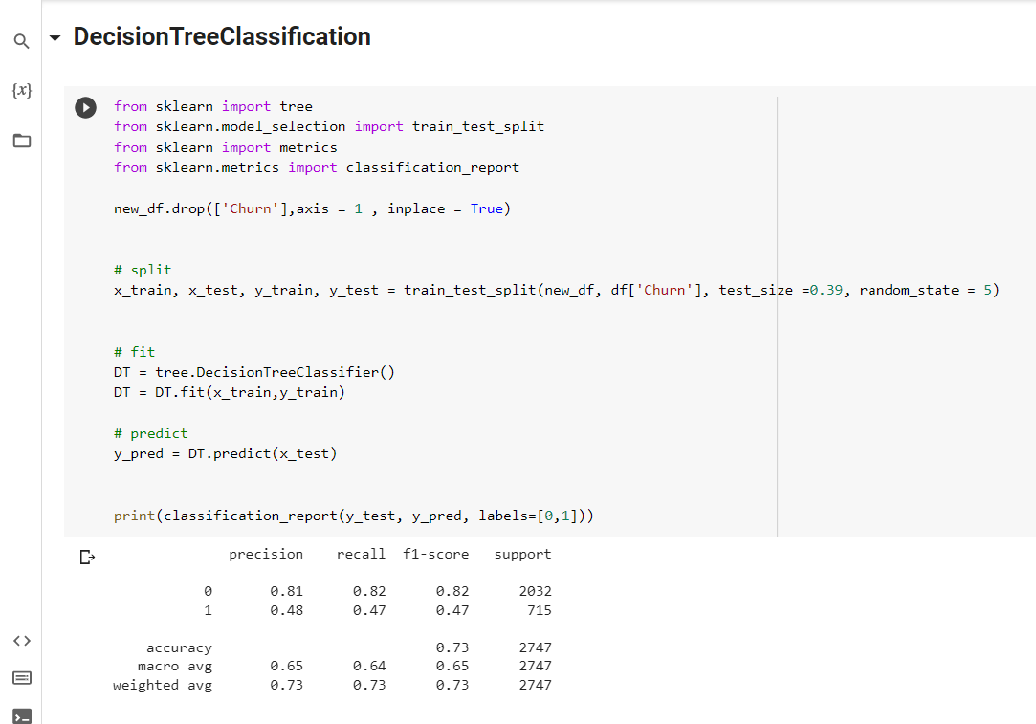

Slide 48
MODEL
01 02
DECISION TREE
(with imbalanced data)
DECISION TREE
(with balanced data)

Slide 49
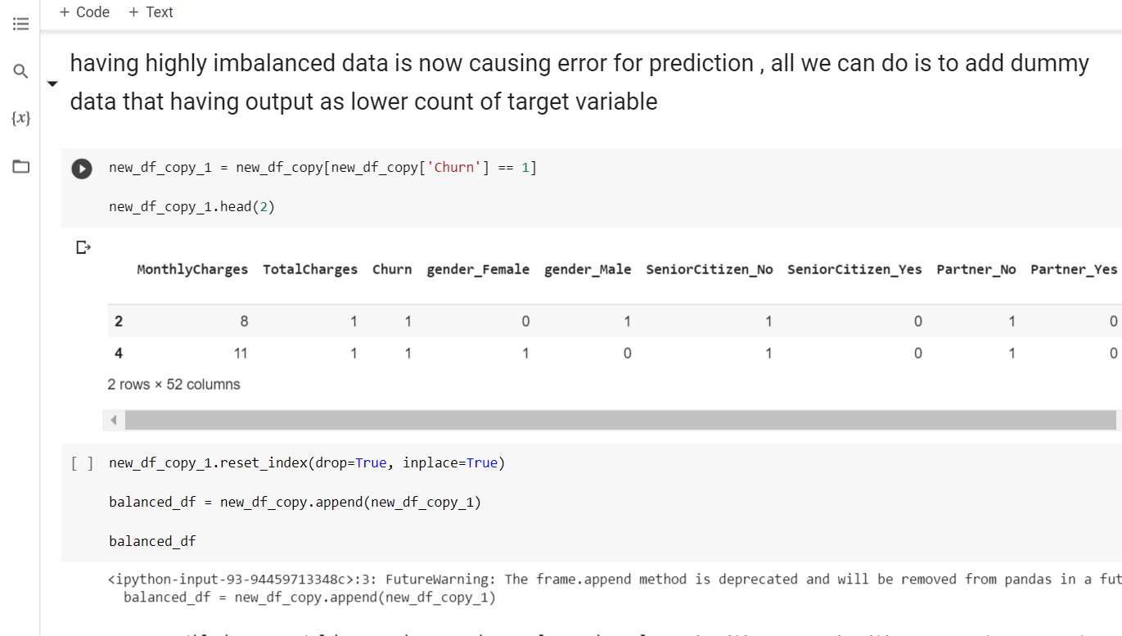
MODEL
01 02
DECISION TREE
(with imbalanced data)
DECISION TREE
(with balanced data)

Slide 50
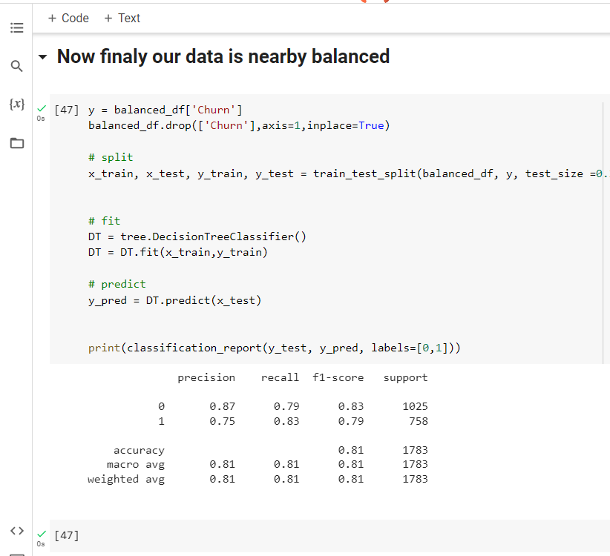
Converting imbalanced data into balanced dataset

Slide 51
Model recall is increased

Slide 52
MODEL
01 02 03
DECISION TREE
(with balanced data)
RANDOM FOREST
(with balanced data)

Slide 53
01 02 03
MODEL
DECISION TREE
(with balanced data)
RANDOM FOREST
(with balanced data)

Slide 54
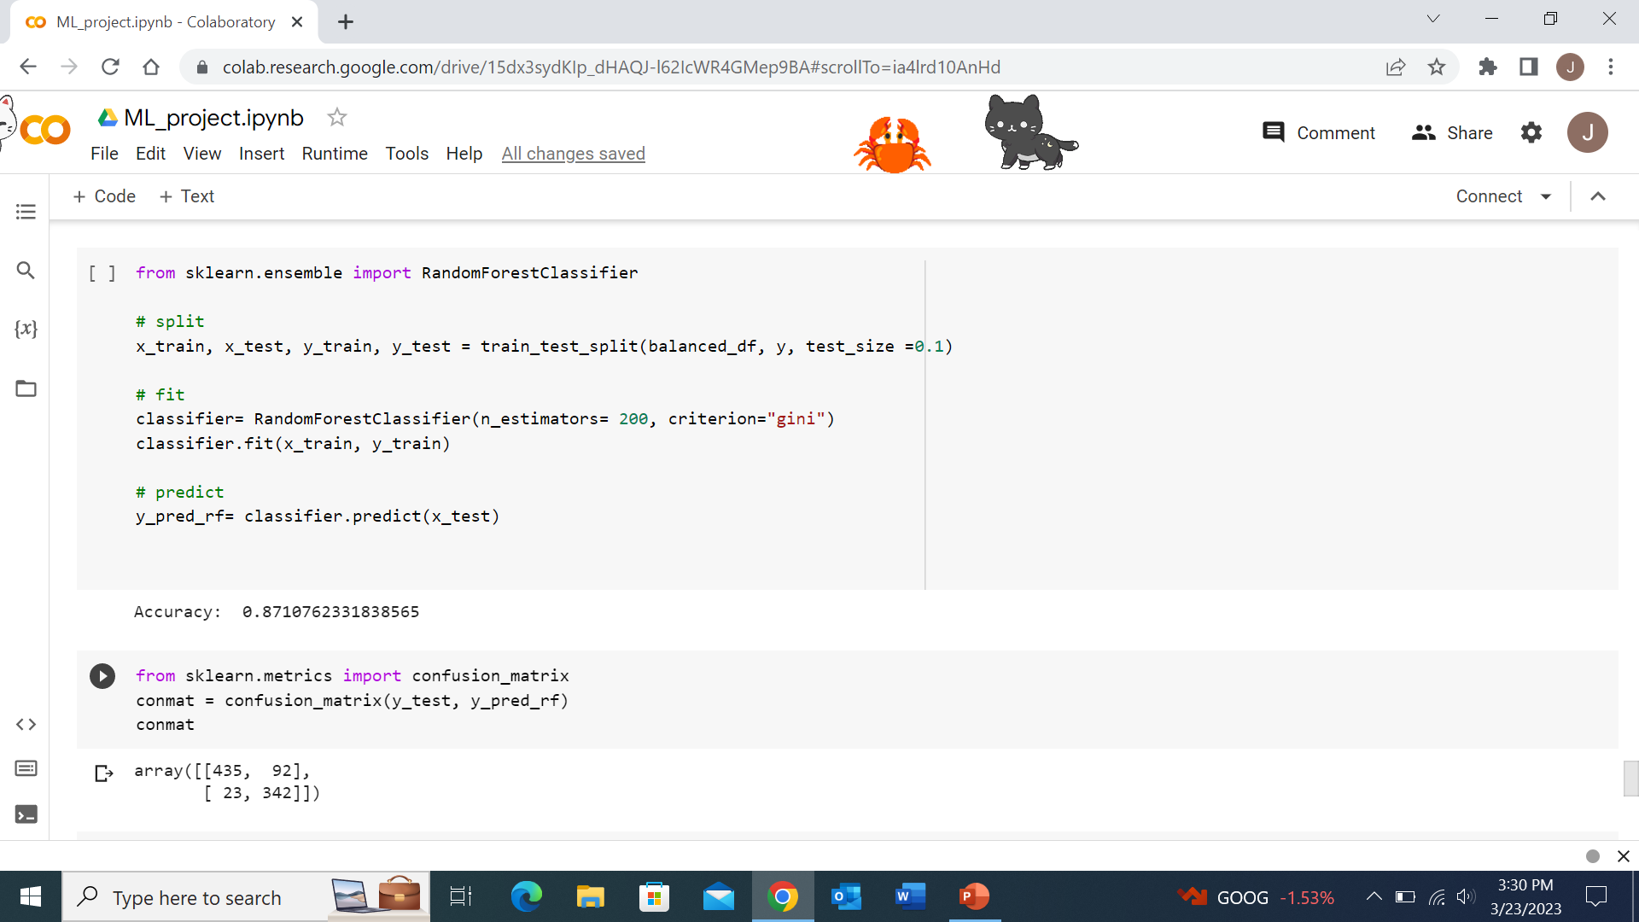
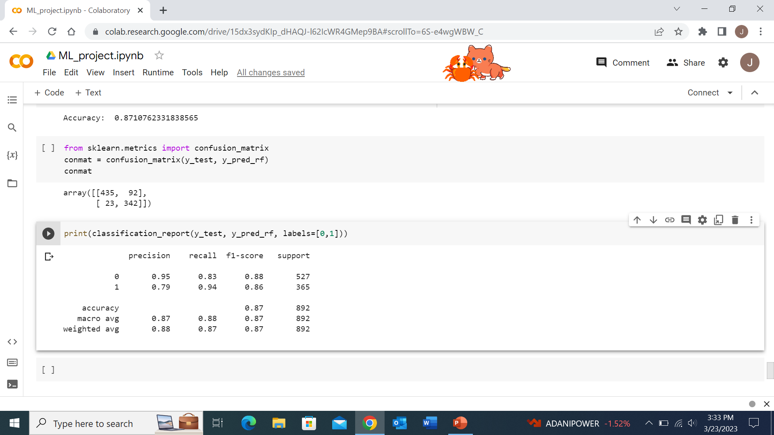
Random forest

Slide 55
Random forest

Slide 56
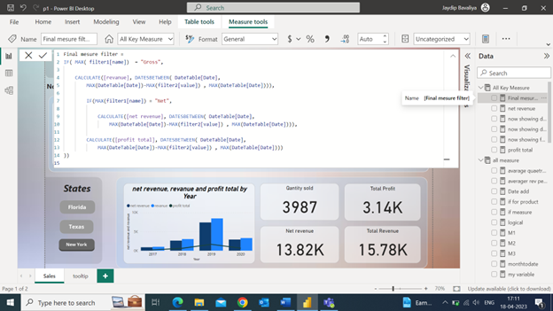
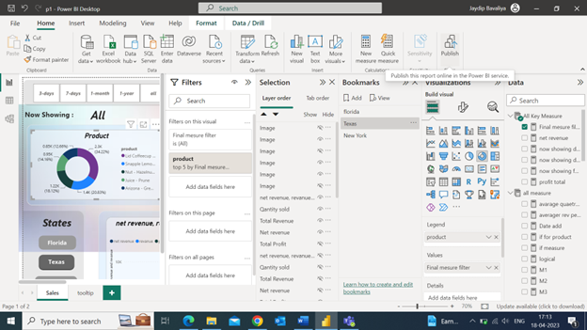
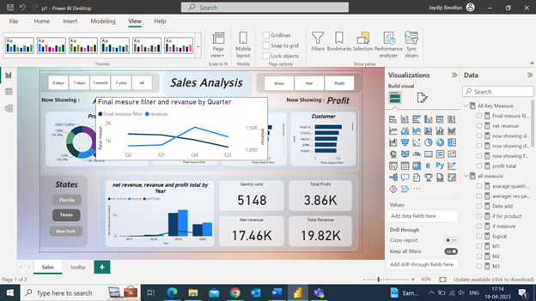
a
Learning Reporting Tool

Slide 57
a
Learning Reporting Tool
DAX

Slide 58
a
Learning Reporting Tool

Slide 59
a
Learning Reporting Tool

Slide 60
Dashboard
01
DECISION TREE
(with balanced data)
RANDOM FOREST
(with balanced data)
(Power BI)

Slide 61
Dashboard
01
DECISION TREE
(with balanced data)
RANDOM FOREST
(with balanced data)
(Power BI)

Slide 62

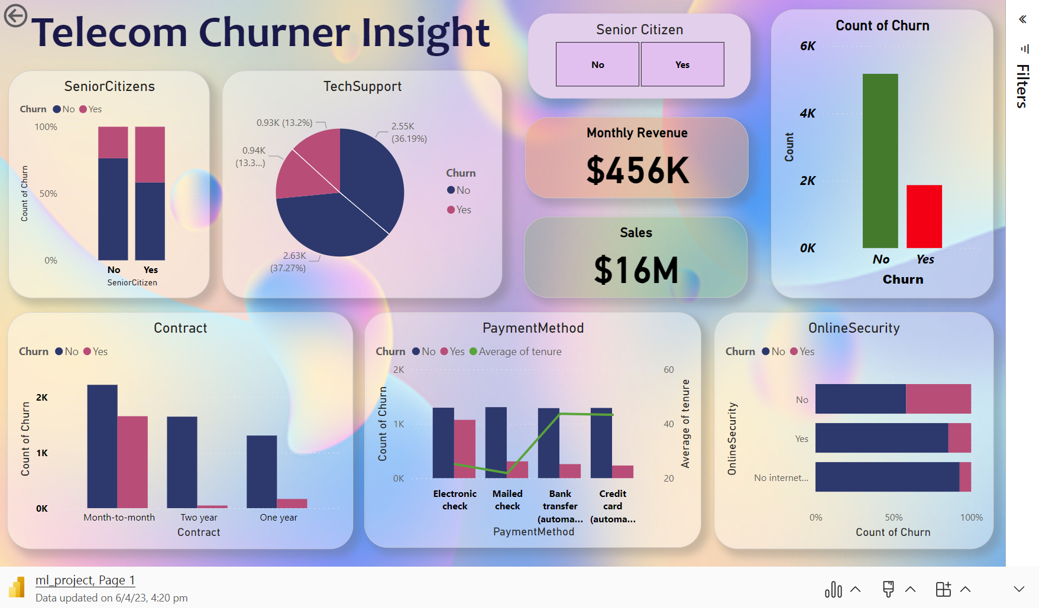

Slide 63
Hosting Project
AWS

Slide 64

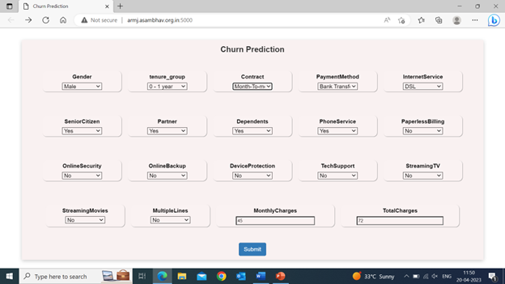
Hosting Project
AWS

Slide 65
Hosting Project
AWS

Slide 66
Hosting Project
AWS

Slide 67

Project link
Project
Project Code link

